Slide 1
Welcome to the game: IT-simulator
This game focuses on speech, this means that in the real game you have to say all your answers.

Slide 2
You are an English- man or woman who will be working in a very popular IT store in London.
Who are you?
How old are you?
Which burrow in London are you from?
Brixton B. Nottingham
C. Paddington D. Kensington

Slide 3
Welcome to your new work place!
Welcome to “Three Oxford street east” we are rated one of the best mobile shops nationwide. We offer our customers guidance and support for their purchases and personal devices. The store will offer you 2 skills you can specialize in: Selling mobile devices and handling complaints. For both skills you will have to do a course level first and after you will be able to specialize even further.

Slide 4
Pick a skill you want to specialize in first.
Selling devices.
Handeling complaints.

Slide 5
Course how to sell devices
In this level, you will get some information first and afterwards answer the multiple choice question.

Slide 6
You can answer the question after the video.
1. What is the function called that automatically adjust your display to your surroundings?
2. What is the camera function called that gives you the possibility to take astrophotos?

Slide 7
What is the function called that automatically adjust your display to your surroundings?
A. Adjustable display
B. Screen brightnener
C. Vision Booster
Notes:
Goede antwoord: C

Slide 8
Wrong answer…

Slide 9
Correct!

Slide 10
What is the camera function called that gives you the possibility to take astrophotos?
A. Fake RAW
B. Expert RAW
C. RAW meat
Notes:
Goede antwoord: B

Slide 11
Wrong answer…

Slide 12
Correct!

Slide 13
You finished the first level!
Great job! Do you want to continue this course or start handeling complaints?
Continue selling devices.
Start course: handeling complaints.

Slide 14
Selling devices together
Okay, you want to go into the store and help customers?
Yes!
No…
Do you want to see the store first?
Yes!
No…

Slide 15
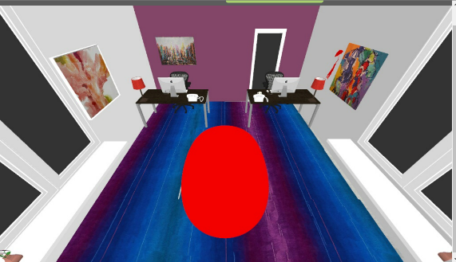
This is what you see when you enter the store.

Slide 16
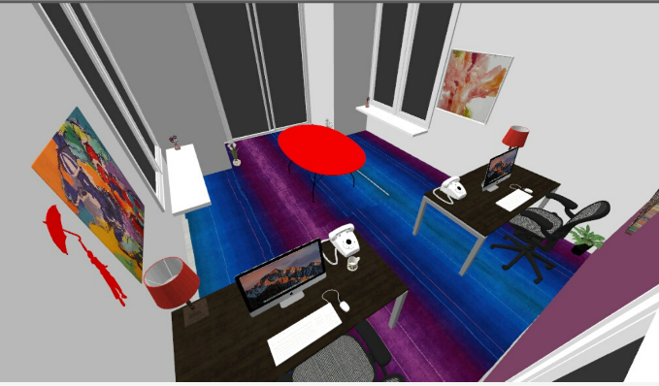
And this is your workplace and view into the store.

Slide 17
Hello can you help me?
I’m not sure I can, but I will try.
I’m sure not can I, I but will try.
I’m sure, but I can’t try.
Notes:
Goede antwoord: I’m not sure I can, but I will try.

Slide 18
Have you seen the store before?
Yes, but show me the store anyway.
Yes and I just want to get to work.

Slide 19
I’m sorry I didn’t understand you.
Try again

Slide 20
That’s the spirit!
Now you should ask the woman how you can help her.
Okay!

Slide 21
Help you, I can.
I can you help how.
How can I help you?
Notes:
Goede antwoord: How can I help you?

Slide 22
I’m sorry I didn’t understand you.
Try again

Slide 23
I’m looking for a phone with the function: Vision Booster.
I would advise the Iphone 13
I would advise the Galaxy S23 ultra
I would advise the Nokia X30
Notes:
Goede antwoord: I would advise the Galaxy S23 Ultra.

Slide 24
I don’t think that is what I’m looking for.
Try again

Slide 25
Great! That’s perfect, thank you.
No problem!

Slide 26
You did great! I think you can handle the store on your own for now. I’ll be at my desk if you need help.
Next level

Slide 27
You’ll be on the floor on your own.
In this level you will need to help customers and once in a while I’ll give you the opportunity to earn some bonuspoints.
You’ll answer the customers by filling in the gaps in the sentences.
Okay! Let’s get started.

Slide 28
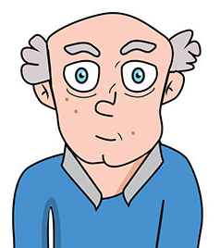
This customer just walked into the store.
Hello sir, …………..
Maybe I can help you?
How can I help you?
What I can help with?
Notes:
Goede antwoord: How can I help you?

Slide 29
I’m not sure I understand what you’re saying.
Try again.

Slide 30
I’m looking for the newest Iphone for my granddaughter.
……………….. the Iphone 14
It isn’t
I would advise
Don’t go for
Bonus time, either help the customer or help me.
Notes:
Goede antwoord: I would advise

Slide 31
Just what she wants, thank you for your help!
No problem! Happy to help!

Slide 32
Why not? I looked it up and Iphone 14 is the newest one.
I’m sorry you are right, I’ll try again.

Slide 33
A customer sent an e-mail. Would you like to respond?
Yes, I would love to.
No, I’ll help the one in the store instead.

Slide 34
Write an e-mail answering the following questions
Answer the customer which phone you would recommend if money was no issue.
Give 3 pro’s for the product.
Give 1 con for the product
Explain why you would choose this phone.

Slide 35
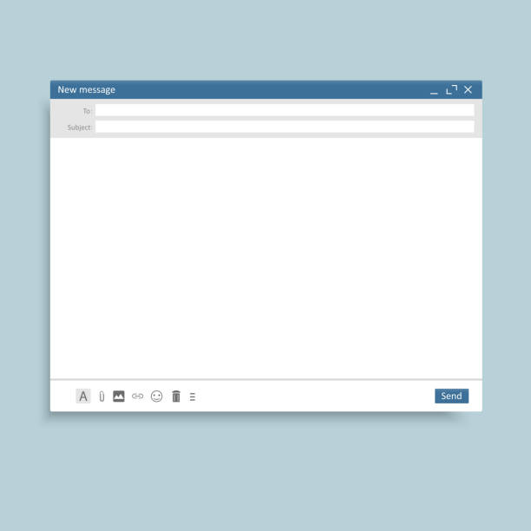
Send
Notes:
In de echte game zouden ze nu een echte mail kunnen schrijven. In dit protoype is die optie er helaas niet.

Slide 36
You did well! Ready for the next level?
Yes let’s go!

Slide 37
I’ll be at the back of the store, the cargo just came in.
Okay! Good luck! I’ll stay here.
Sure! I’ll handle the store on my own.

Slide 38
Hi there, I’m looking for a phone. Can you help me?
You: What ……………………?
I’m not sure which brand yet.
You: How …………………?
I’d like to spend a maximum of £800.
You: ………. advise …………
Samsung S21 FE
Phone catalogue.
Moterola edge 40 Pro
Notes:
Goede antwoord: Samsung S21 FE
De rest van de invulling van de zinnen mag de student in dit geval zelf bepalen.

Slide 39
That’s too expensive I don’t want that.
Try again.

Slide 40
Advise

Slide 41
That’s perfect! Thank you!
No problem!

Slide 42
You did great and I think you’re ready for the last level. Did you finish the course on how to handle complaints?
Yes!
No, I still have to learn how to handle complaints.

Slide 43
Course: how to handle complaints
Course: how to handle complaints.
In this level, you will get some information first and afterwards answer the multiple choice question.

Slide 44
You can answer the question after the video.
What’s the first thing you should do when talking to a customer?
What do most (angry) customers want?
Notes:
What’s the first thing you should do?
Stay calm
What do most (angry) customers want?
For their problems to be acknowledged

Slide 45
What is the first thing you should do, when talking to an angry customer?
A. Get angry too
B. Stay calm
C. Walk away
Notes:
Goede antwoord: B

Slide 46
Wrong answer…

Slide 47
Correct!

Slide 48
What do most angry customers want?
A. Advice on the situation.
B. A solution for the problem.
C. For their problems to be acknowledged.
Notes:
Goede antwoord: C

Slide 49
Wrong answer…

Slide 50
Correct!

Slide 51
You finished the first level!
Great job! Do you want to continue this course or start selling devices?
Continue handeling complaints.
Start course: selling devices.

Slide 52
Handeling complaints together.
Okay, you want to go into the store and help customers?
Yes!
No…
Do you want to see the store first?
Yes!
No…

Slide 53
This is what you see when you enter the store.

Slide 54
And this is your workplace and view into the store.

Slide 55
Have you seen the store before?
Yes, but show me the store anyway.
Yes and I just want to get to work.

Slide 56
Hello can you help me?
I’m not sure I can, but I will try.
I’m sure not can I, I but will try.
I’m sure, but I can’t try.
Notes:
Goede antwoord: I’m not sure I can, but I will try.

Slide 57
I’m sorry I didn’t understand you.
Try again

Slide 58
That’s the spirit!
Now you should ask the woman how you can help her.
Okay!

Slide 59
Please can help you?
How can I help you?
Help you I can maybe?
Notes:
Goede antwoord: How can I help you?

Slide 60
I’m sorry I didn’t understand you.
Try again

Slide 61
I have a complaint about my phone, it doesn’t charge anymore.
I can clean out the access point for you and see if it works.
I can charge it for you here.
I don’t see what the compaint is.
Notes:
Goede antwoord: I can clean out the access point for you and see if it works.

Slide 62
Excuse me?!
Try again.

Slide 63
That doesn’t seem like a solution
Try again.

Slide 64
That would be great, thank you.
No problem, here you go!

Slide 65
You did great! I think you can handle the store on your own for now. I’ll be at my desk if you need help.
Next level

Slide 66
You’ll be on the floor on your own.
In this level you will need to help customers and once in a while I’ll give you the opportunity to earn some bonuspoints.
You’ll answer the customers by filling in the gaps in the sentences.
Okay! Let’s get started.

Slide 67
This customer just walked into the store.
Hello sir, …………..
Maybe I can help you?
How can I help you?
What I can help with?
Notes:
Goede antwoord: How can I help you?

Slide 68
I’m not sure I understand what you’re saying.
Try again.

Slide 69
The letters on my phone are too small! I can’t read anything.
……………….. Let me show you
You can change that in your settings.
Change your settings.
Bad setting you have.
Notes:
Goede antwoord: You can change that in your settings

Slide 70
Sorry what did you just say?
Try again.

Slide 71
Thank you so much! Now I can read the news again.
No problem! Happy to help!

Slide 72
Great work! I have a meeting with a client. Don’t contact me please, only in case of emergency.
Okay! Good luck! I’ll stay here.
Sure! I’ll handle the store on my own.

Slide 73
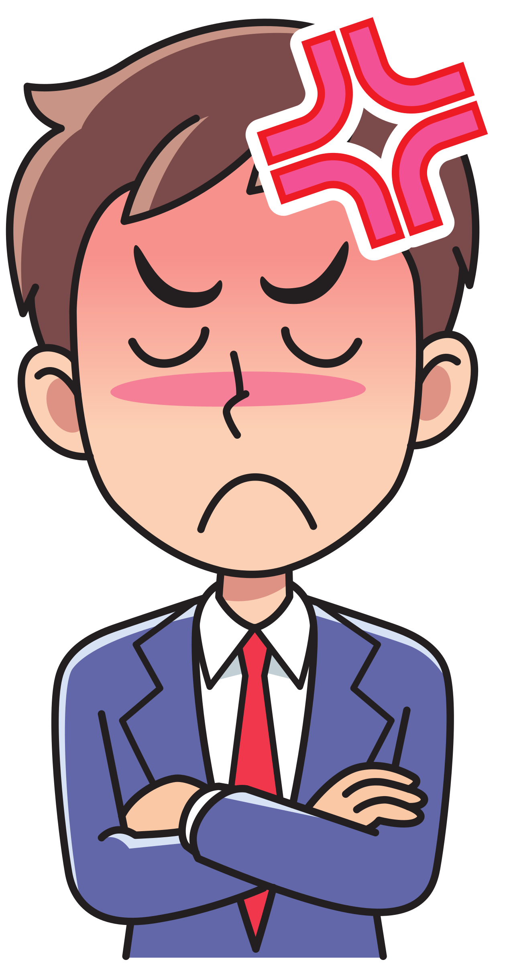
The service here is terrible!
You: Sorry ……………………?
Sorry you’ll be!
You: Could you ……………. happened?
Last week they said they would call me back within 24 hours, but it’s been 7 days and I still haven’t heard a thing!
You: ….. apologize, …….. I can …… you?
Maybe you can, maybe you can’t.
You: What ………?
The problem is that my phone hasn’t arrived yet and I’ve been waiting for 2 weeks!
Check the system.
Ask the manager.
Notes:
Goede antwoord: Check the system.
De rest van de invulling van de zinnen mag de student in dit geval zelf bepalen.

Slide 74
I told you not to bother me! Get out!
Leave and check the system anyway.

Slide 75
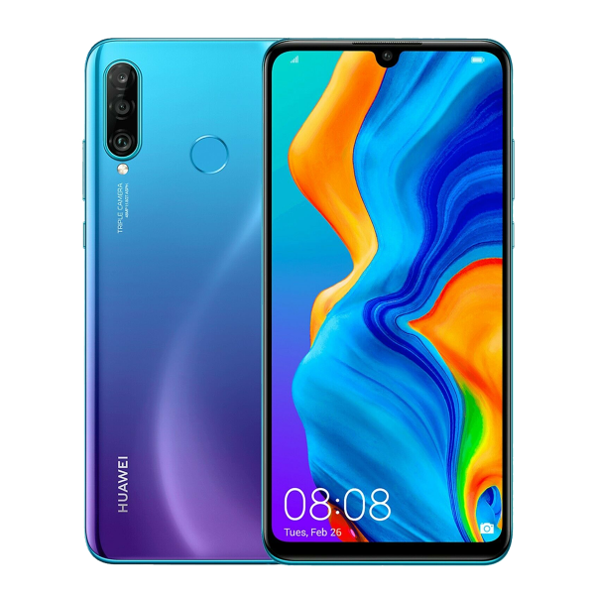
Item: Huawei P30 light
in stock: 1

Slide 76
And?!
You: There’s …. in stock, I’ll give it to you now and cancel the order. Since you paid by creditcard you can just leave the store.
Apalogize again while he leaves.

Slide 77
You handled that last one perfectly on your own! Good job! That was it, I think you’re ready. Did you finish the course about selling devices?
Yes
No, I’ll do that now.

Slide 78
Have you done both courses and all the levels?
Yes!
No, I still have to learn how to handle complaints.
No, I still have to learn how to sell devices.

Slide 79
Oh no! I just got a call that my daughter is in the emergency room, I need to go! You’ll be on your own for now.
Okay! I’ll handle the store

Slide 80
Help whoever you can, the best you can.

Slide 81
I’m looking for A phone that can take Astrophotos
……………………………………..
End level
Notes:
De invulling van de zinnen mag de student in dit geval zelf bepalen.

Slide 82
I have a complaint about the camera! It takes awfull pictures.
………………………………………………………
End level
Notes:
De invulling van de zinnen mag de student in dit geval zelf bepalen.

Slide 83
Can you help me choose a phone for my wife?
…………………………………………………………..
End level
Notes:
De invulling van de zinnen mag de student in dit geval zelf bepalen.

Slide 84
You did great handeling the store on your own. Congratulations you are now officially a trained employee!
Thank you so much, I loved training here, I think I’ll love working here even more!

